Slide 1
FAMILY LAW
Introduction
ANU College of Law
Dr Anne Macduff
Notes:
AM

Slide 2
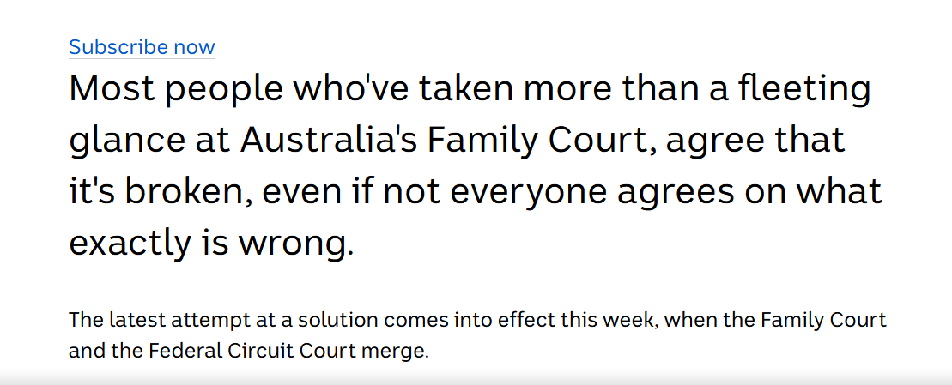
Family Law in the news ….

Slide 3


Family Law in the media …

Slide 4


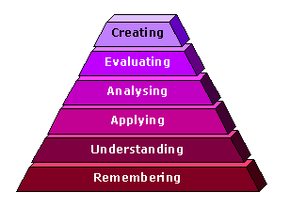
Course Design

Slide 5
The structure of the course

Slide 6
Week 3:
Going Deeper: Evaluation and Critique
Creating
Evaluating
Analysing
Week 1, 2:
Broad Knowledge, Application, and Skills
Analysing
Applying
Understanding
Remembering

Slide 7
Week 3:
Going Deeper: Evaluation and Critique
Law Reform submission
(Reflection)
Week 1, 2:
Broad Knowledge, Application, and Skills
Workshops
Quizzes
Online Tests
(Moot)

Slide 8
Independent + Supported learning

Slide 9
Discussion/ Peer feedback

Slide 10
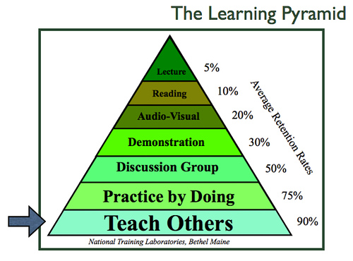

Slide 11

The learning sandwich
Reading (see reading guides)
Lectures
Workshops
4. Self testing (review) quizzes
Picture sourced at: http://www.justrec.com/ideas-for-healthy-and-tasty-breakfasts/healthy-sandwich/

Slide 12
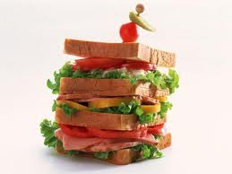
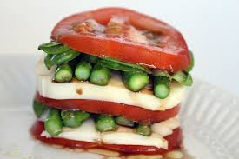
What will your learning sandwich be?
OR
Use your Mondays, Fridays and weekends wisely to review, catch-up and/ or get ahead
Picture sourced at: http://sega-addicts.murnaumusic.com/?attachment_id=10624

Slide 13

1. Online Quiz
0%
This online quiz is a multiple choice quiz designed to provide you with formative feedback on your understanding of key content covered in week 1.

Slide 14

2. Workshop participation
≥5 out of 11 workshops
It is VERY important that you scan the Q Code at the start of each workshop to record your attendance at a workshop. This will be the ONLY evidence of attendance accepted as attendance.

Slide 15

3. Online Test
50%
Students undertake the online test under ‘examination conditions’. It will cover the material covered in the entire course, including guest lectures. There will be two parts.
Part A will be a multiple choice quiz (worth 20%). You will not be able to go backwards and forwards through the questions.
Part B will involve longer written answers (30%). It will be a hypothetical problem scenario. There is no word limit.

Slide 16
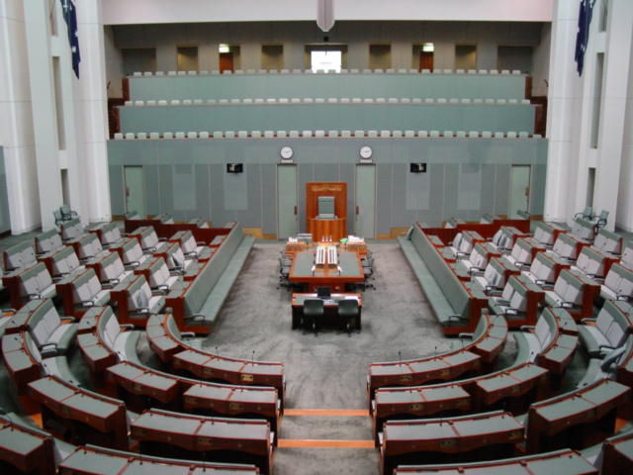
4. Research Task: Law Reform Inquiry
50%
This is a ‘research task’. Use the reading guides provided to you as a starting point, but it is expected that you will go BEYOND the provided reading to complete the task. You MUST locate and draw on multiple sources of reliable material, and analyse the material to support an argument for a law reform recommendation.

Slide 17

5. Optional Reflection
10%
This task is NOT a course evaluation, nor a description of your cognitive learning in this course (i.e. what you have come to understand better as a result of finishing the course). I strongly encourage you to use the template provided in the workshop, and in the ‘reflection resources’ in the Assessment section of the course wattle site.

Slide 18

6. Optional Moot
10%
Supported by local Family Law specialist firm Farrer Gesini & Dunn, an optional family law moot will be conducted.
Also end of course celebratory event! Friday 1 July @6pm

Slide 19
Bits and pieces
Questions?
EAP (extra time for online test)
End of course event (FGD hosting)

